Slide 1



Gavin Wiggins (ORNL)
Stuart Daw (ORNL)
Jack Halow (Separation Design)
Low-Order Modeling of Biomass Particle Mixing and Reaction in a Bubbling-Bed Fast Pyrolysis Reactor
AIChE 2014 Annual Meeting
Thursday, Nov. 20, 2014
Computational
Pyrolysis
Consortium
http://energy.ornl.gov/cpc

Slide 2





Background
The work presented here is part of the Computational Pyrolysis Consortium (CPC), a multi-lab activity sponsored by DOE’s Bioenergy Technologies Office (BETO).
The main goal of the CPC is to develop computational tools that support the assessment of advanced catalytic technologies for producing infrastructure compatible transportation fuels from biomass-derived pyrolysis oils.
Computational
Pyrolysis
Consortium

Slide 3
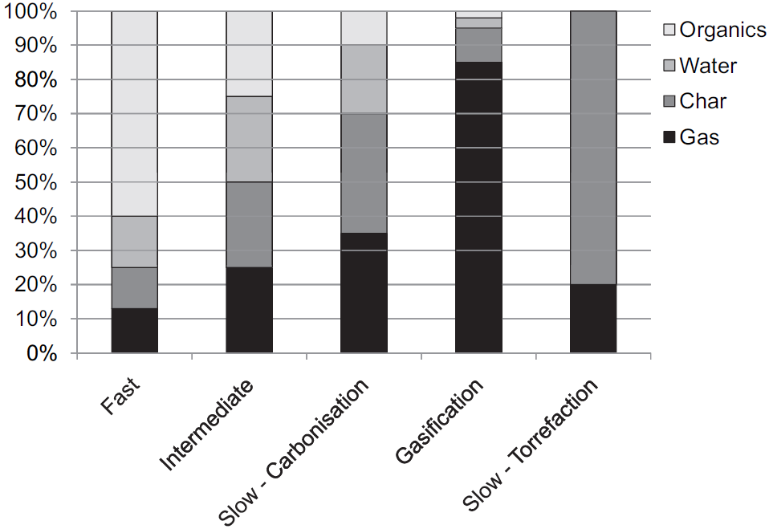
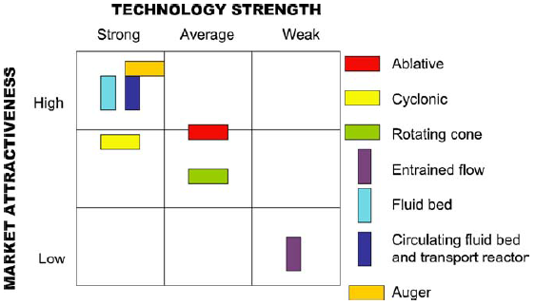
Fast pyrolysis of biomass
Pyrolysis involves rapid heating of biomass in the absence of air or oxygen to produce noncondensable gases, solid char, and liquid.
Goal of fast pyrolysis is to maximize the production of liquid yield (a.k.a. bio-oil or tar).
The liquid can be stored and transported, and used for energy, chemicals or as an energy carrier. [Bridgwater 2012]
bubbling bed reactors
bio-oil
Product distribution from different types of pyrolysis, Source: Bridgwater 2012
Commercial potential of fast pyrolysis technologies, Source: Butler 2011

Slide 4
Bubbling bed reactors are widely used for fast pyrolysis
Geldart Group B (sand) bed particles with or without catalysts
Bed fluidized under no-oxygen conditions
Raw biomass injected as particles and removed as char
Biomass typically < 1% of bed mass
Bed temperature 425-600°C
Very rapid heating rate (up to 1,000°C/s)
Mixing and particle RTD very important to product composition and conversion
Tar (liquid), Char, Gas
Raw Biomass
Non-Condensable Gas
Bubbling
Fluidized Bed Reactor
Feed Handling
and Preprocessing
Cyclone
Quench
Cooler
Biomass
Feedstock
Char and Solids
Bio-Oil to Upgrading
Fluidizing Gas

Slide 5
Objectives
Create low-order reactor models (LORM) with the following characteristics
  fast-executing (can be run on a desktop computer)
  open-source tool for the broader pyrolysis community
  account for rate-limiting steps in
    particle-scale mixing
    heat and mass transfer
    secondary reactions (including catalytic) of the released pyrolysis gases
Configure those models to facilitate rapid screening of process and scale-up options for industry and research community

Slide 6
Modeling Approach
Create the following models:
Sub-model for intra-particle biomass heat-up and reaction
Statistical biomass particle mixing sub-model
Gas-phase reaction/convection sub-model for released gases
Diffusion/boundary layer sub-model for pyrolysis products
Global reactor model to integrate the sub-models
focus of today’s discussion
Integrated Low-Order Reactor Model (LORM)
Intra-Particle
Sub-Model (LOIP)
Reactor
Mixing
Sub-Model
(LOPM)
Gas Mixing and Kinetics

Slide 7

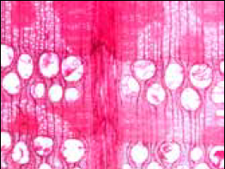
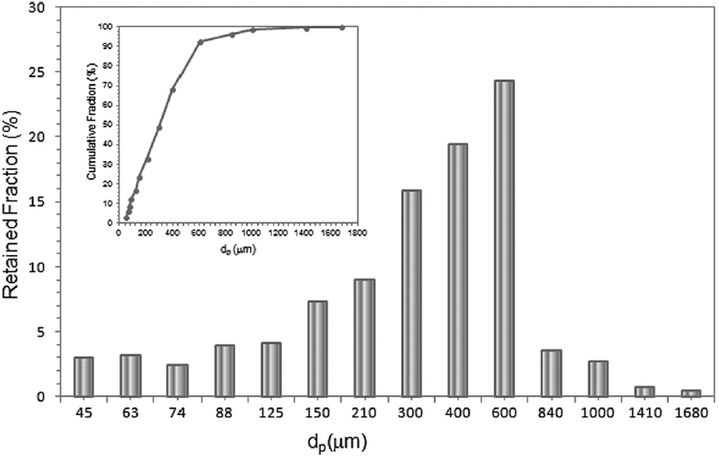
Biomass Particle-Scale Modeling Challenges
Literature on intra-particle kinetics is inconsistent , typically available for limited experiments.
[Chan 1985, Di Blasi 1993, Babu 2003, Gronli 2000, Kersten 2005, Prakash 2008, Shafizadeh 1982]
Available pyrolysis models treat biomass particles as “one” size, but grinders and mills often produce broad distributions of sizes.
[Di Blasi 2002, Bryden 2002, Chaurasia 2003, Cui 2007, Galgano 2003, Galgano 2004, Gronli 2000, Haseli 2011, Janse 2000, Koufopanos 1991, Kung 1972, Larfeldt 2000, Miao 2011, Papadikis 2009]
Particle surface boundary conditions are highly complex. [Papadikis2010]
Biomass is typically anisotropic and inhomogeneous with wide variations among different species.
[Chaurasia 2003, Babu 2004, Gronli 2000, Haseli 2011, Koufopanos 1991, Kung 1972, Larfeldt 2000, Okekunle 2011, Papadikis 2010, Prakash 2009, Pyle 1984, Sadhukhan 2009]
Softwood - Pine
Hardwood - Oak
Source: Wood Handbook 2010
Size distribution for Douglas fir wood chips ground in a hammer mill at 1.6 mm screen size, Source: Tannous 2013

Slide 8
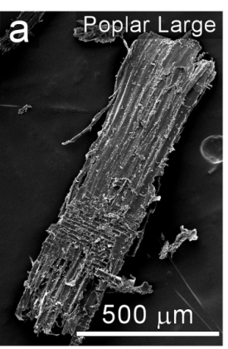
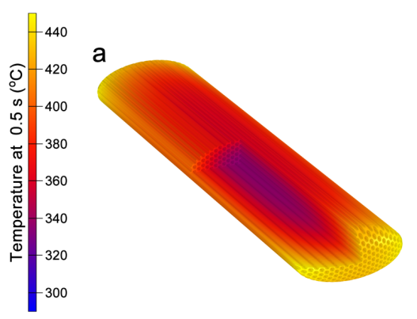
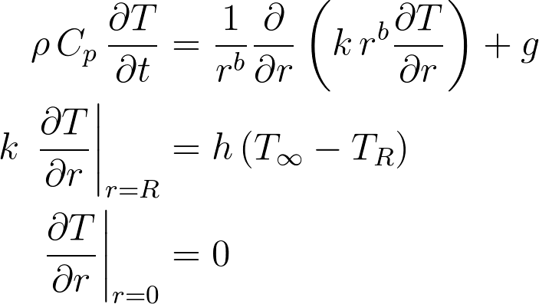
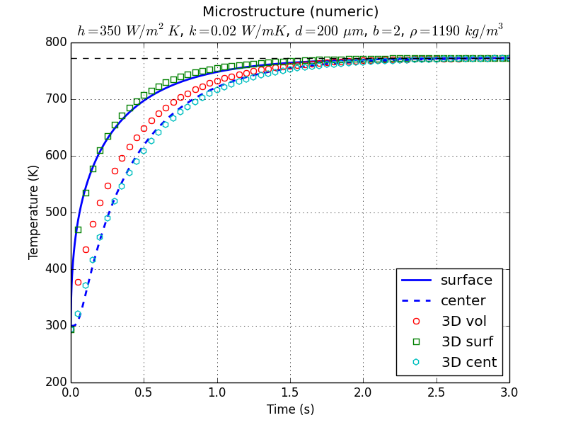
Low-Order Intra-Particle (LOIP) Model
SEM image of
wood particle
Particle Heat-Up
Most important temperature gradients are along narrowest dimension
Approximate heat-up as 1-D conduction with average properties and simple B.C.
Microstructure
Model
Low-Order
Model
where ρ = density (kg/m³)
C_{p} = heat capacity (J / kg·K)
k = thermal conductivity (W / m·K)
T = temperature (K)
T∞ = ambient temperature (K)
T_{R} = surface temperature (K)
r = radius (m)
b = shape factor of 0=slab, 1=cylinder, 2=sphere
g = heat generation (W/m³)
h = heat transfer coefficient (W / m²·K)
Temperature profile of 3-D microstructure model (NREL) and low-order intra-particle model. Heat transfer via surface convection and conduction only.
Notes:
construct 3-D particle geometries from micrographs of wood
analyze 3-D particle model at fast pyrolysis conditions
validate and compare 3-D results with low-order model

Slide 9
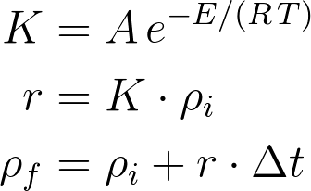
LOIP kinetics are based on available data
Available kinetics are typically very simplified
Primary and secondary reactions produce gas, tar (condensable liquid or bio-oil), and char
Non-condensable gases
  light gases such as H₂, CO, CO₂, H₂O, CH₄, etc.
Condensable volatiles
  heavy organics and inorganics
  vapors and aerosols react within and/or outside particle
Char as solid residue
Typically 1st order Arrhenius
Primary Reactions
Secondary Reactions
gas
1
4
gas
biomass
2
tar
3
5
char
char
Chan1985 and Blasi1993 kinetic parameters
Reaction | A (1/s) | E (kJ/mol)
1 | 1.3e8 | 140
2 | 2e8 | 133
3 | 1.08e7 | 121
4 | 4.28e6 | 108
5 | 1e6 | 108
where A = pre-factor (1/s)
E = activation energy (kJ/mol)
R = universal gas constant (kJ / mol·K)
r = reaction rate (ρ/s)
ρ = concentration (kg/m³)
∆t = time step (s)
LOIP model is configured to allow multiple user specified kinetics and internal transport schemes to account for future improvements in kinetic information.

Slide 10
Other LOIP Assumptions
Particle does not shrink
Thermal properties (c_{p}, k) vary with temperature
Catalytic effects of ash are neglected
Gases immediately leave the particle
Effects of mass transport are not accounted for
q_{conv} = h_{c} (T ∞ - T_{s})
biomass particle
gas
tar
char
char
gas
T ∞ = 425-600°C

Slide 11
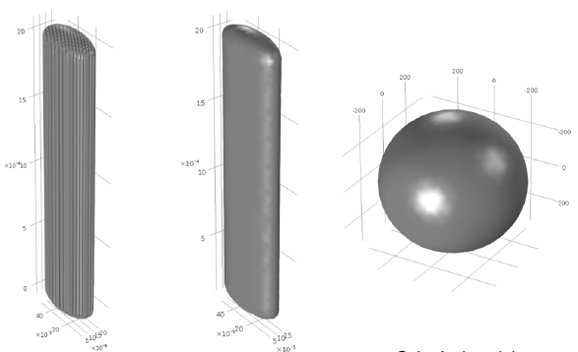
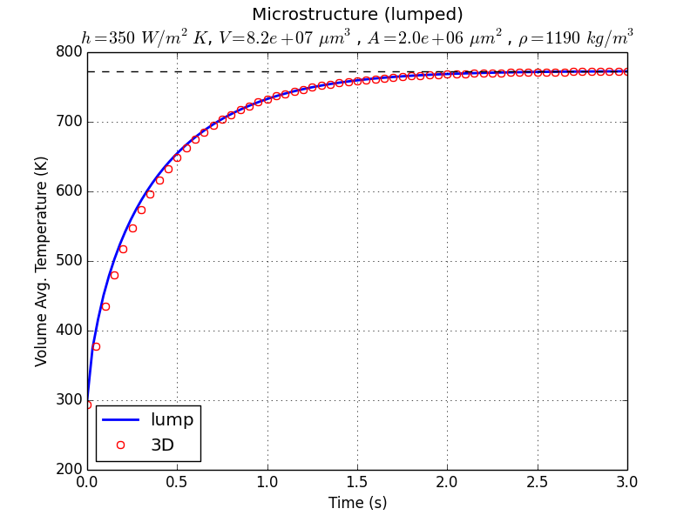
LOIP appears to reasonably approximate 3D heat-up
Low-order vs 3-D Microstructure Model
Lumped method agrees with 3-D results for skeletal density of 1190 kg/m³
1-D approach provides good agreement using minimum particle width and spherical shape factor
k_{eff} value same as N₂ gas

Slide 12
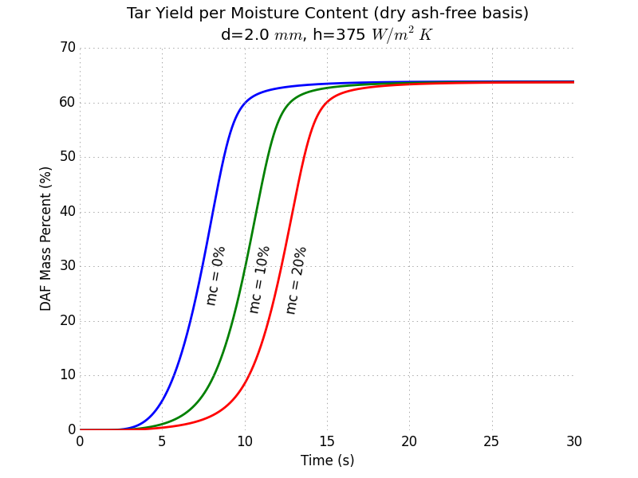
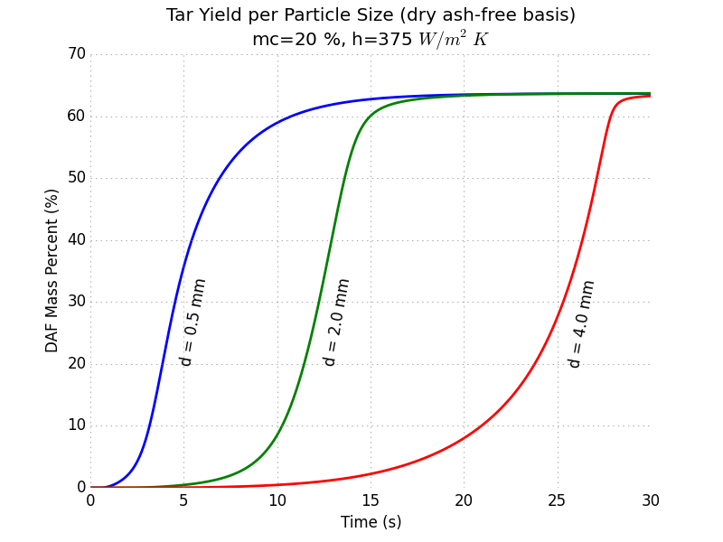
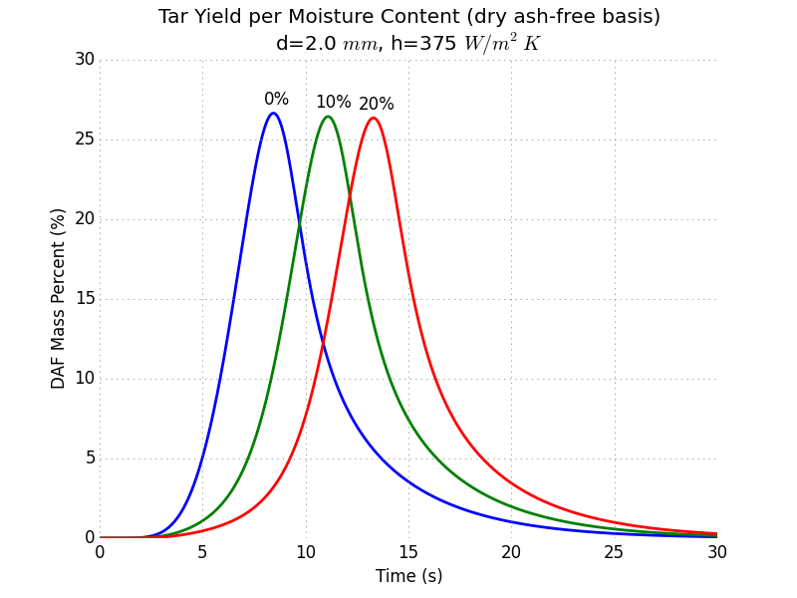
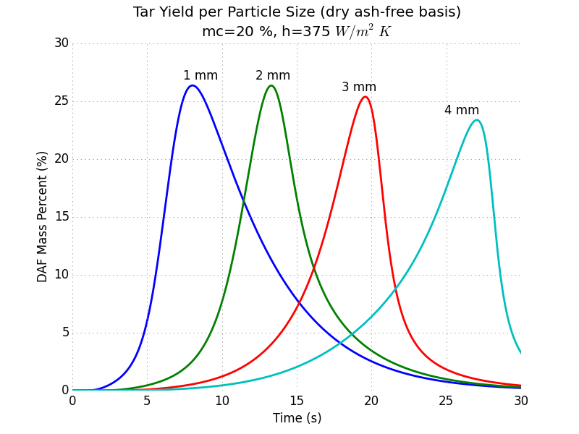
LOIP heat transfer and kinetics reveal important trends
Primary Reactions
Best Case Scenarios: Offers a liquid yield of ≈64% for a dry 2.0 mm spherical particle. As particle size increases, time to reach peak liquid yield increases.
Worst Case Scenarios: Drastically decreases max liquid yield to ≈27% for a dry 2.0 mm spherical particle. As particle size increases, time to reach peak liquid increases while the max yield decreases.
Tar yield (aka liquid or bio-oil yield) at different moisture contents (left) and particle sizes (right). Represents optimal liquid yield (no secondary reactions) where vapor and gas immediately leave particle.
Primary+Secondary Reactions
Tar yield at different moisture contents (left) and particle sizes (right). Represents the effect of secondary reactions cracking tar to gas and char.

Slide 13
Particle and Gas Mixing Challenges
Turbulent mixing of biomass particles in bubbling beds is highly complex.
[Xiong 2013, Papadikis 2010, Radmanesh 2005]
Mixing depends on particle properties (size, density) and local flow conditions and involves recirculation and segregation.
[Di Blasi 2008, Cui 2007, Wang 2005, Kunii 1991]
Internal temperature and concentration gradients can be significant as reactor scale increases.
Detailed CFD simulations of mixing require high computational overhead and time, which increase with reactor scale.
[Mellin 2014, Papadikis 2009]
Plot of CFD mixing simulation
from MFIX - Sreekanth / Emilio
Plot of typical characteristic
particle RTD - Stuart

Slide 14
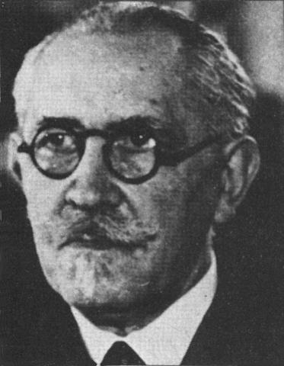
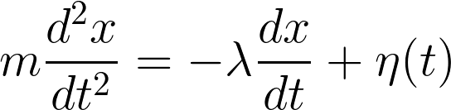
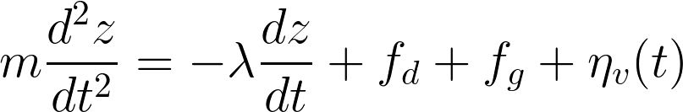
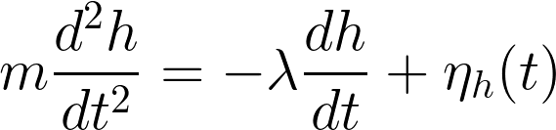
Low-Order Particle Mixing (LOPM) Model
Langevin Model
Originally proposed by Paul Langevin to describe Brownian motion
Langevin, Paul. "Sur la théorie du mouvement brownien." CR Acad. Sci. Paris 146.530-533 (1908)
We propose a modified version of this model for biomass particles in bubbling beds for the vertical direction
where f_{d} = time average gas drag, f_{g} = gravitational force, η_{v}(t) = vertical perturbations
A similar force balance can be written for horizontal particle position except that we assume no time-average drag or gravitational forces
where η_{h}(t) = horizontal perturbations
where x = distance, t = time, m = particle mass,
λ = friction coefficient,
η(t) = stochastic perturbations
Paul Langevin
(1872-1946)

Slide 15
The LOPM is formulated as a random walk
Approximating derivatives over discrete time intervals and combining and rearranging terms for vertical motion
where z(t) = axial position at time t, η’_{v}(t) = vertical stochastic particle shifts
a,b,c = empirical parameters that reflect time average forces
a, b, and c can be estimated with experimental particle position time series
Stochastic inputs, η’(t), can be estimated from stepwise prediction errors
For horizontal motion
where y(t) = lateral position at time t, η’_{h}(t) = horizontal stochastic particle shifts
a, b = empirical parameters that reflect time average forces
In vectorized form, the random walk can be applied to thousands of particles simultaneously and adjusted at each time step for changing particle properties
See Ind. Eng. Chem. Res., 2014, 53 (41), pp 15836–15844 for more details.

Slide 16

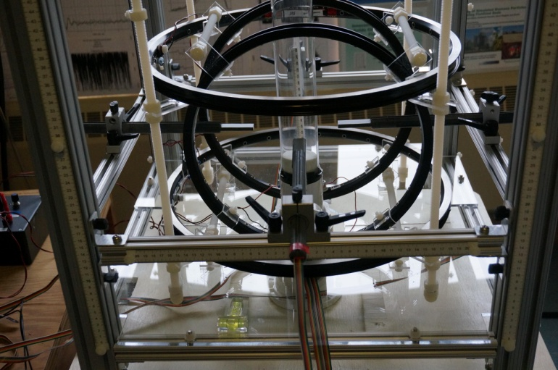
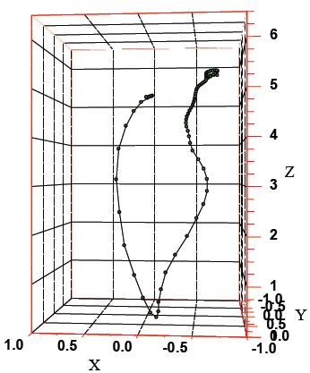
Experimental validation of LOPM predictions
Simulated biomass (tracer) particles are constructed by inserting tiny neodymium magnets into balsa wood cylinders (typically > 1 mm diameter, 0.4-1 g/cc)
Bed particles (207 µm glass, 2.5 g/cc) are fluidized with ambient air (1.0 ≤ U/U_{mf} ≤ 5.0)
Single tracer particles are injected in bed at specific fluidization conditions and tracked
Special algorithms de-convolute signals to give 3-D particle trajectory
Experimental facility at Separation Design Group Lab, designed and operated by Jack Halow
Tracer Particle (simulated biomass particle)
Experimental Setup
3-D particle
Trajectory

Slide 17
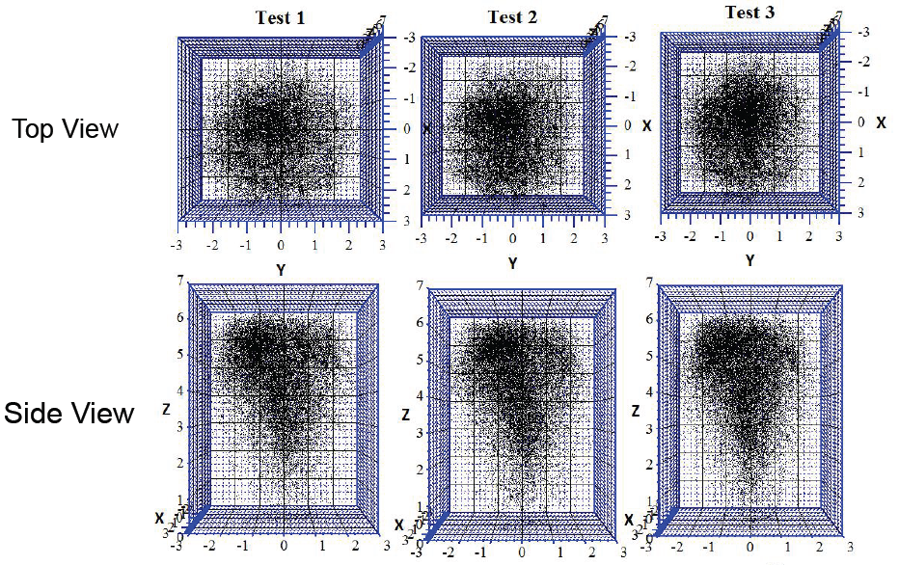
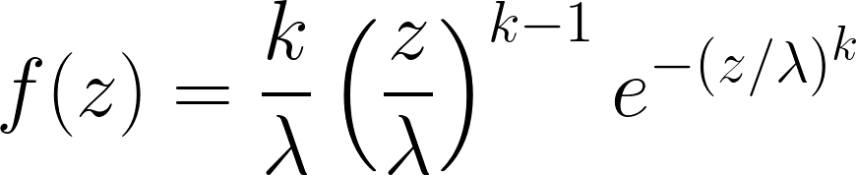
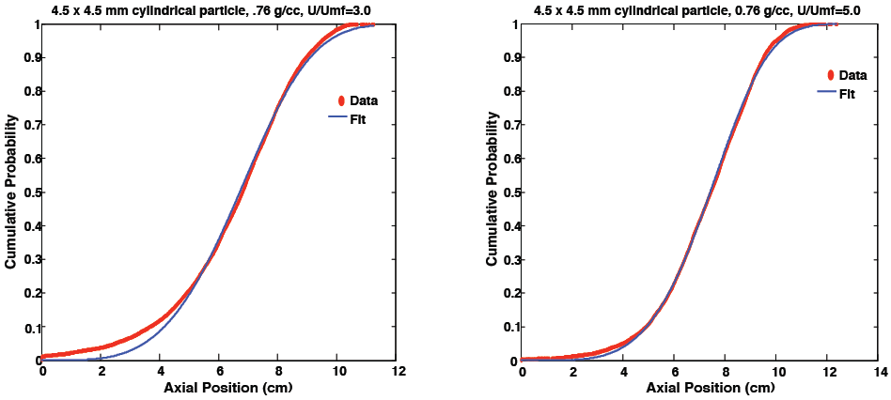

Both LOPM & experiments yield particle RTDs
Trajectories map of 3-D time-average mixing.
Vertical mixing profiles follow Weibull statistics.
where f = probability density function
C = cumulative distribution function
k = shape parameter
λ = scale parameter
z = axial position

Slide 18
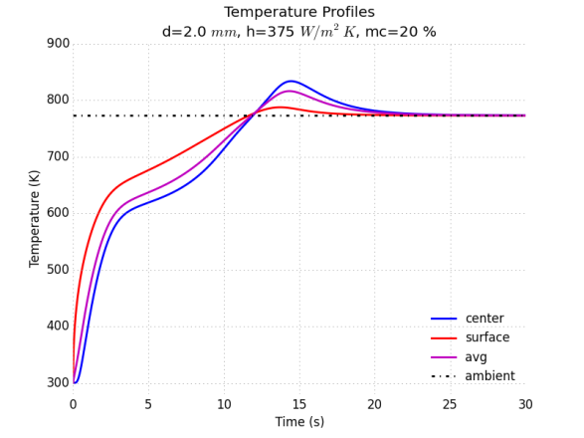
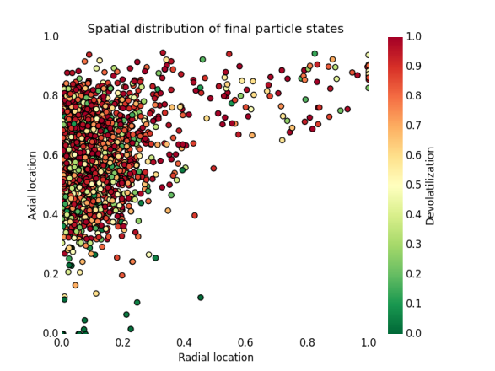
Integrated Pyrolysis Reactor Model
Integrated Low-Order Reactor Model (LORM)
Intra-Particle
Sub-Model (LOIP)
Reactor
Mixing
Sub-Model
(LOPM)
heat transfer
mass transport
thermal properties
physical characteristics
moisture content
Gas Mixing and Kinetics
fluidization scheme
residence times
reactor height / diameter
bed height
feedstock injection
chemical species
devolatilization rate
liquid yield
secondary reactions
gas
1
4
gas
biomass
2
tar
3
5
char
char
LOIP sub-model tracks gas release and evolution of multiple particle sizes
LOPM sub-model mixes particles via random walk with changing parameters
Released gases undergo further reaction and mixing before exiting reactor
Notes:
gas as non-condensable volatiles = H2, CO, CO2, H2O, CH4 (light gases)
tar as condensable volatiles = heavy organics & inorganic molecules, escape solid phase as vapor & liquid in a mist or aerosol form

Slide 19
Results of LOIP and LOPM studies to date
Complex 3D intra-particle heat transfer appears to be reasonably well approximated by simplified 1D model with appropriate thermal property assumptions
Available simple pyrolysis kinetics appear to yield realistic trends in liquid yield with particle size and moisture, but more detailed kinetics are needed to account for liquid product composition
Biomass particle RTDs generated by simple random walks appear to be consistent with magnetic tracer measurements and exhibit Weibull statistics
More experimental data are needed to correlate the random walk parameters with particle properties and fluidization conditions

Slide 20
Next Steps…
Add more detailed intra-particle mass transfer and kinetics (Ranzi2008, 2013) to the LOIP
Add improved estimates for the impact of particle properties on the LOPM random walk parameters (based on CFD and/or experiments)
Develop sensitivity trends (for operating, feedstock, and scale parameters) in raw bio-oil yield and quality from combined LOPM+LOMM simulations
Compare above sensitivity predictions with available experimental lab and pilot data
Conduct specific experiments needed to confirm prediction accuracy of models and better inform scale-up

Slide 21
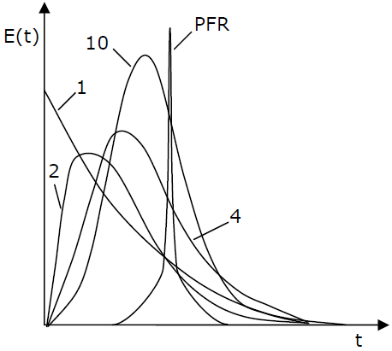
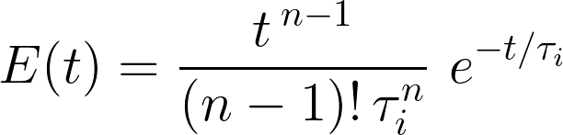
Next Steps…
Model gas RTD as combination of PFRs and CSTRs based on CFD and experimental measurements
as number of tanks increase,
RTD approaches PFR
where E(t) = residence time distribution function
t = time
n = reactors
τ_{i} = residence time in one of the reactors
RTD for 1, 2, 4, 10 tanks and a PFR, Source: Wittrup 2007

Slide 22
Acknowledgements
Prasad Gupte: DOE Project Manager
U.S. Department of Energy, Bioenergy Technologies Office
Emilio Ramirez, Sreekanth Pannala, Charles Finney, Stuart Daw
ORNL CPC Team Members
Collaborators
Peter Ciesielski, National Renewable Energy Lab
Victor Walker, Tyler Westover, Idaho National Lab
Jack Halow, Separation Design Group

Slide 23



Reactor
Model
Publications on the LOIP and LOPM sub-models are in process and supplemental information will be available on the CPC website.
Particle
Model
Gavin Wiggins: wigginsg@ornl.gov
CPC website: http://energy.ornl.gov/cpc
Python code: https://github.com/pyrolysis
Computational
Pyrolysis
Consortium

Slide 24
Backup Slides

Slide 25
Parameters and Assumptions
3-D Models | Low-order Models
volume and density of sphere and shell are equal, ρ = 540 kg/m³
microstructure density represented as cell wall density
heat transfer via conduction and convection at surface (no kinetic reactions)
k = 0.12 W/m·K | shell diameter as average of L+W
C_{p} = (103.1+3.86*T) J/kg·K | k = 0.12 (wood) - 0.02 (N₂ gas) W/m·K
identical thermal capacity | C_{p} = (103.1+3.86*T) J/kg·K
spatial distribution of mass
V_{A}, ρ_{A}
V_{B}, ρ_{B}
Microstructure (porous)
Shell (solid)
V_{B}, ρ_{B}
V_{A} (solid) < V_{B}
Sphere (solid)
mass = V_{A} ρ_{A} = V_{B} ρ_{B}
ρ_{A} = V_{B} ρ_{B} / V_{A}
H = 2000 µm
d = 700 um
W = 540 µm
L = 200 µm

Slide 26
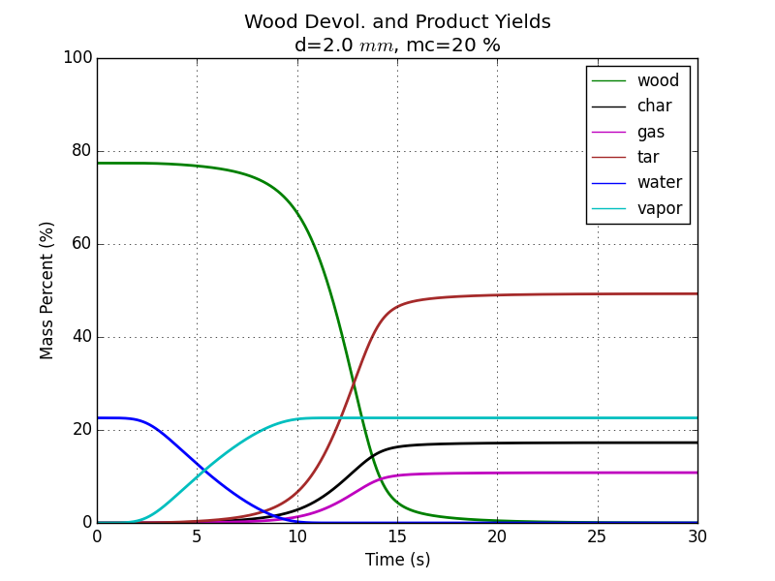
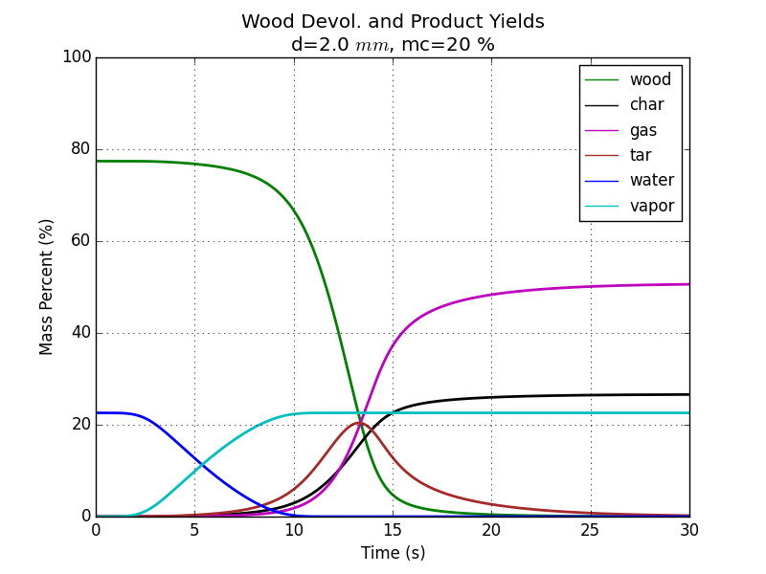
Particle parameters affect pyrolysis yields thru the reaction steps
Even the simplest proposed kinetic schemes involve both parallel and sequential competing reactions.
Best Case Scenarios: Liquid yield is high if the optimal tar formation temperature is reached quickly and the tar products escape quickly from the particle and encounter no further char or catalysts in the reactor to drive the secondary reactions.
Worst Case Scenarios: Liquid yield is low if tar formation is slow (vs. the primary gas and char reactions) and/or the initial tar has opportunities to crack within or outside the particle. Particle mass transport and reactor mixing determine the importance of the secondary reactions.
Primary Reactions
Secondary Reactions
Reaction | A (1/s) | E (kJ/mol)
1 | 1.3e8 | 140
2 | 2e8 | 133
3 | 1.08e7 | 121
4 | 4.28e6 | 108
5 | 1e6 | 108
gas
1
4
gas
biomass
2
tar
3
5
char
char
Wood devolatilization and product yields for 2 mm particle at 20% moisture content.
(Top) Optimal conditions within particle
(Bottom) Worst-case scenario

Slide 27
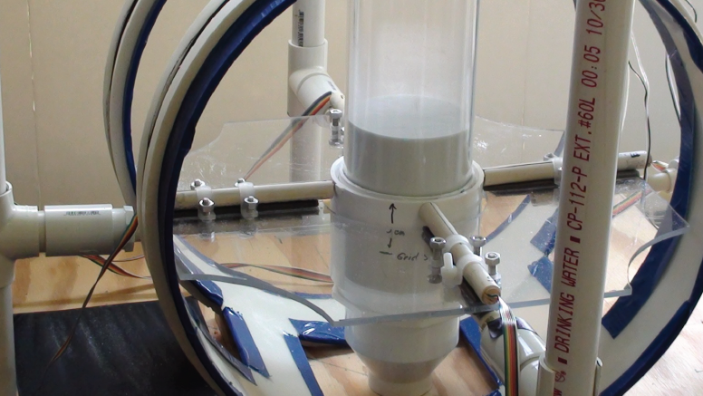
Experimental Setup
Probes aligned North, South, East, West
Helmholtz coils modify earth’s magnetic field in bed
Non-metallic bed and supports
100 Hz sampling rate, 5 minute runs (30,000 data points)
Porous plate distributor
Magnetic Coils
Probes

Slide 28
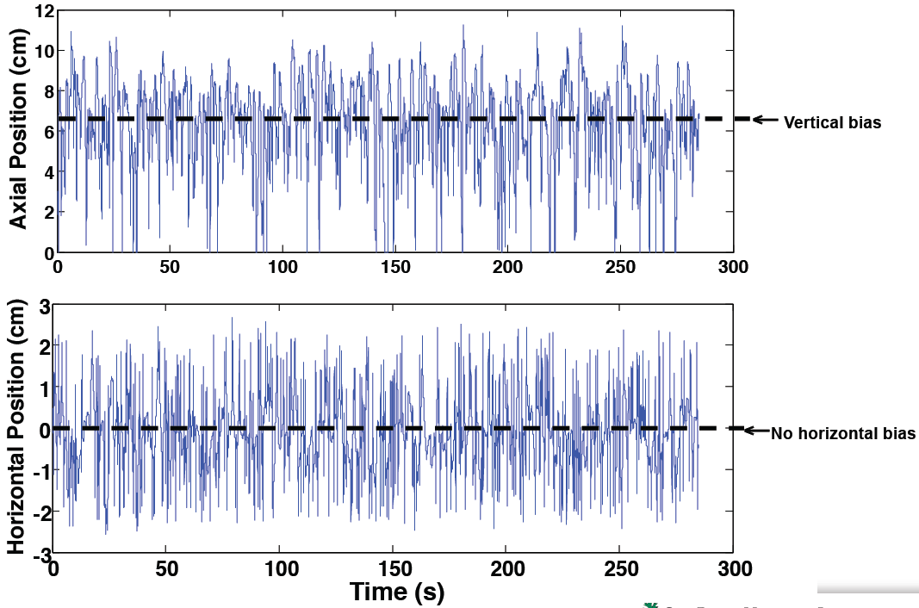
Time series data reveal particle motion dynamics

Slide 29
Next Steps…
Couple the Ranzi kinetic scheme to the heat transfer model to estimate chemical species from biomass pyrolysis
biomass
cellulose
lignin
hemicellulose
5 H₂O + 6 Char
K₄
0.8 HAA + 0.2 Glyox + 0.1 C₂H₄O + 0.25 HMFU
0.3 C₃H₆O + 0.21 CO₂ + 0.1 H₂ + 0.4 CH₂O
+ 0.83 H₂O + 0.02 HCOOH + 0.61 Char
CELL
CELLA
K₁
K₂
K₃
Source: Ranzi 2008, 2013
LVG
Develop an appropriate definition for the “diameter” or “size” of a wood particle that is used for pyrolysis modeling

Slide 30
Computational Pyrolysis Consortium (CPC)
Members of the Consortium
Coordination of the CPC team with industry advisors and university partners
CFD of biomass pyrolysis reactors
Low-order models for pyrolysis and upgrading reactors
Multi-stage model integration
Micro-to-pilot-scale reactor data
Biomass particle-scale reaction and transport models
Catalytic vapor-phase kinetic models
CFD of vapor-phase catalytic upgrading
Identification of critical TEA inputs
Hydro-treating and aqueous upgrading catalyst data
Non-polar and polar liquid phase catalytic kinetic models
Integrated liquid catalytic reactor models
Identification of critical TEA inputs
Biomass feedstock characterization tools and data
Model component and data sharing/archiving mechanism
Vapor-phase catalytic molecular energetics
Fundamental bio-oil vapor thermodynamic properties
Identification of potential catalysts for vapor-phase upgrading
Assess the commercial feasibility of advanced catalytic technologies for producing infrastructure compatible transportation fuels from biomass-derived pyrolysis oils.

